Slide 1
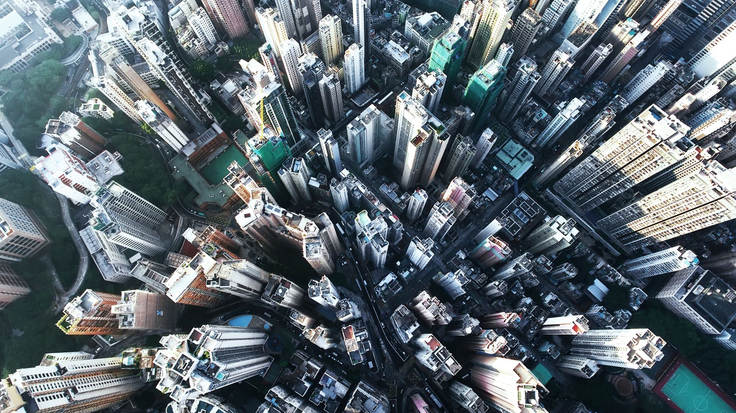
San Francisco Crime Data
By: Caroline Amalie Fuglsang-Damgaard

